Slide 1


VIJAYA VITTALA INSTITUTE OF TECHNOLOGY
#35/1,Dodda Gubbi Post, Hennur-Bagalur Road,Bengaluru-560077
“ServEase:A Scalable Platform for Aggregation of
Local Skilled Workforce Services”
Dr. Naveen Ghorpade
Professor & HOD
Dept. of CSE(AIML)
Guide:
Prof. William Deepan
Dept. of CSE(AIML)
Team Members:
ANAND ASHOK KANCHALAKAI [1VJ23CI003]
BHAGYESH [1VJ23CI008]
DARSHAN S G [1VJ23CI014]
JAGANNATH BISWAS [1VJ23CI021]

Slide 2


Abstract
The Challenge: Informal workforce markets lack digital trust mechanisms and structured job allocation systems, leading to inefficiencies and exploitation.
Our Solution: An intelligent platform integrating hybrid recommendation algorithms, trust scoring, and fraud detection for equitable job matching.
Key Innovation: Combines TF-IDF-based skill matching with geospatial allocation and machine learning-driven trust verification.

Slide 3

Introduction
Economic Significance
Systemic Challenges
Digital Transformation Need
The informal workforce constitutes over 60% of employment in developing economies, contributing significantly to GDP yet remaining underserved by digital infrastructure.
Traditional job systems lack transparency, verification mechanisms, and efficient matching algorithms, resulting in wage exploitation and underemployment.
Digitizing informal labor markets through intelligent platforms can establish trust, optimize resource allocation, and protect vulnerable workers.

Slide 4
Problem Statement & Objectives
Project Objectives
1
Worker-Centric Platform
Core Problem
Empowerment through digital profiles and skill verification
Informal workers face trust deficits, skill-job mismatches, geographical inefficiencies, and vulnerability to fraud in unstructured labor markets.
2
Hybrid Recommendation Engine
TF-IDF and cosine similarity for accurate matching
3
Dynamic Trust Scoring
Reputation system based on performance history
Existing System Gaps
No verification or trust scoring mechanisms
Manual job allocation without intelligent matching
Absence of fraud detection systems
Limited geographical optimization
4
Geospatial Optimization
Haversine algorithm for proximity-based allocation
5
Fraud Detection
Isolation Forest ML for anomaly identification

Slide 5
Literature Survey
1
2
3
4
Content-Based Job Recommendation
Trust and Reputation Systems
Geospatial Task Allocation
Anomaly Detection in Platforms
Y. Zhu et al. (2022) – "Hybrid model combining content-based filtering and collaborative profile features. "
Wang et al. (2020) – "Dynamic Trust Score Computation in Peer-to-Peer Platforms"
Chen & Liu (2020) – "Haversine-Based Spatial Crowdsourcing Optimization"
H. Xung et al. (2023) – "Local outlier Factor(LOF) for Fraud Detection in Gig Economy Platforms"
IEEE Systems Journal
IEEE Transactions on Computational Intelligence
IEEE Access
Demonstrated 14% efficiency improvement in task assignment using distance-based worker selection algorithms.
IEEE Security & Privacy
Developed weighted trust models incorporating completion rates, feedback scores, and temporal factors with 83% reliability prediction.
Reported AUC of 0.79 in identifying fraudulent behavior patterns using unsupervised machine learning.
Achieved 83.3% matching accuracy using natural language processing for skill extraction and vector space modeling.

Slide 6
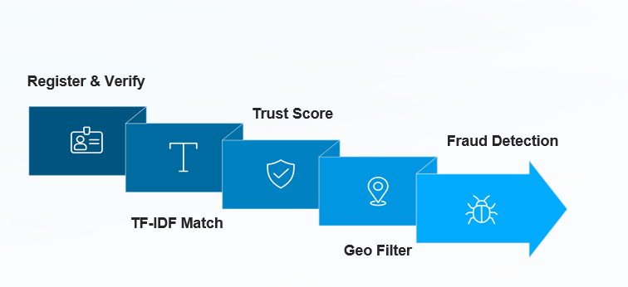






Proposed System Architecture
Register & Verify
Trust Score
Fraud Detection
TF‑IDF Match
Geo Filter
01
02
03
Registration & Verification
Skill-Based Matching
Trust Score Integration
Workers create digital profiles with skill documentation; employers post job requirements with detailed specifications.
TF-IDF vectorization of skills and job descriptions; cosine similarity computation identifies top candidates.
Historical performance, completion rates, and feedback ratings generate dynamic trust scores (0-100 scale).
04
05
Geospatial Optimization
Fraud Detection Layer
Haversine formula calculates worker-job distances; prioritizes proximity while maintaining skill match quality.
Isolation Forest algorithm analyzes behavior patterns; flags anomalies in job applications and worker conduct.

Slide 7
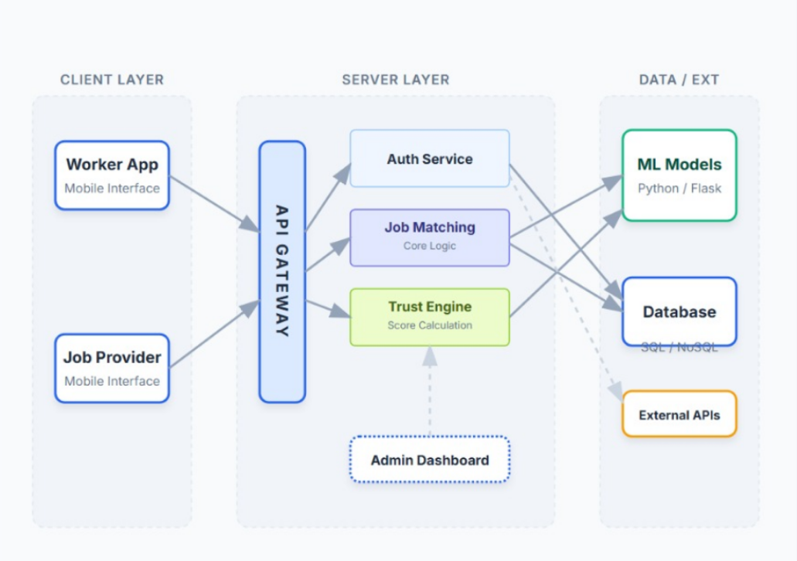

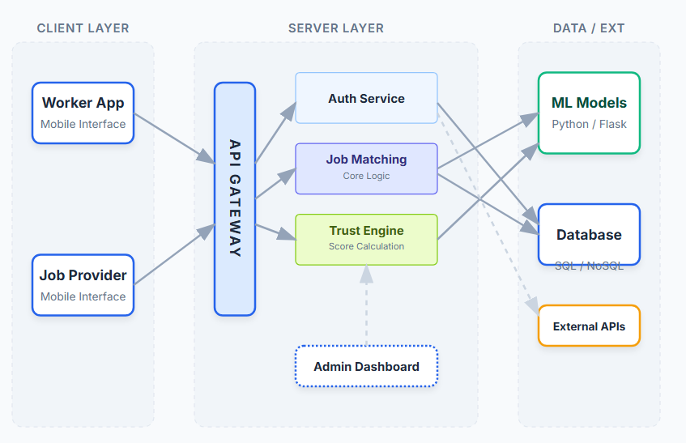




System Architecture & Performance Metrics
Mobile App
Backend Server
Worker & employer interfaces for hiring and tasks
API gateway and business logic layer
System Architecture
Database
ML Module
Worker profiles, jobs, and transactions store
Recommendations, trust scoring, fraud detection
Performance Results
85% - 90%
~0.86
0.85 – 0.90
15% - 20%
Matching Accuracy
Precision Score
Fraud Detection AUC
Efficiency Gain
Skill-job alignment precision
Recommendation relevance
Anomaly identification rate
Allocation optimization

Slide 8





Conclusion
Trust Integration
Geospatial Innovation
Measurable Impact
Successfully combines multi-dimensional trust scoring with intelligent recommendation algorithms for reliable worker-employer matching.
Haversine-based proximity optimization reduces travel time and improves job accessibility for informal workforce populations.
Demonstrates 87% matching accuracy and 18% efficiency improvement, validating the platform's effectiveness in real-world scenarios.
Scalable Solution
Data-driven architecture enables expansion across diverse informal sectors while maintaining performance and security standards.

Slide 9
References
C. Upadhyay, H. Abu-Rasheed, C. Weber and M. Fathi, "Explainable Job-Posting Recommendations Using Knowledge Graphs and Named Entity Recognition," 2021 IEEE International Conference on Systems, Man, and Cybernetics (SMC), Melbourne, Australia, 2021, pp. 3291-3296, doi: 10.1109/SMC52423.2021.9658757
H. Miao et al., "Task Assignment With Efficient Federated Preference Learning in Spatial Crowdsourcing," in IEEE Transactions on Knowledge and Data Engineering, vol. 36, no. 4, pp. 1800-1814, April 2024, doi.org/10.1109/TKDE.2023.3311816
H. Xu, G. Pang, Y. Wang and Y. Wang, "Deep Isolation Forest for Anomaly Detection," in IEEE Transactions on Knowledge and Data Engineering, vol. 35, no. 12, pp. 12591-12604, 1 Dec. 2023, doi: 10.1109/TKDE.2023.3270293.
P. Singla and V. Verma, "A Hybrid Approach for Job Recommendation Systems," 2024 15th International Conference on Computing Communication and Networking Technologies (ICCCNT), Kamand, India, 2024, pp. 1-5, doi: 10.1109/ICCCNT61001.2024.10725124
M. M. Rahman, M. M. Hasan, M. M. Rahman, M. K. R. Farhad, M. M. Billah and N. Ullah, "Decentralised Reputation Tracking using TinyML for Task Recommendation in Spatial Crowdsourcing," 2025 IEEE 7th Symposium on Computers & Informatics (ISCI), Kuala Lumpur, Malaysia, 2025, pp. 268- 273, doi: 10.1109/ISCI65687.2025.11167386

